Slide 1
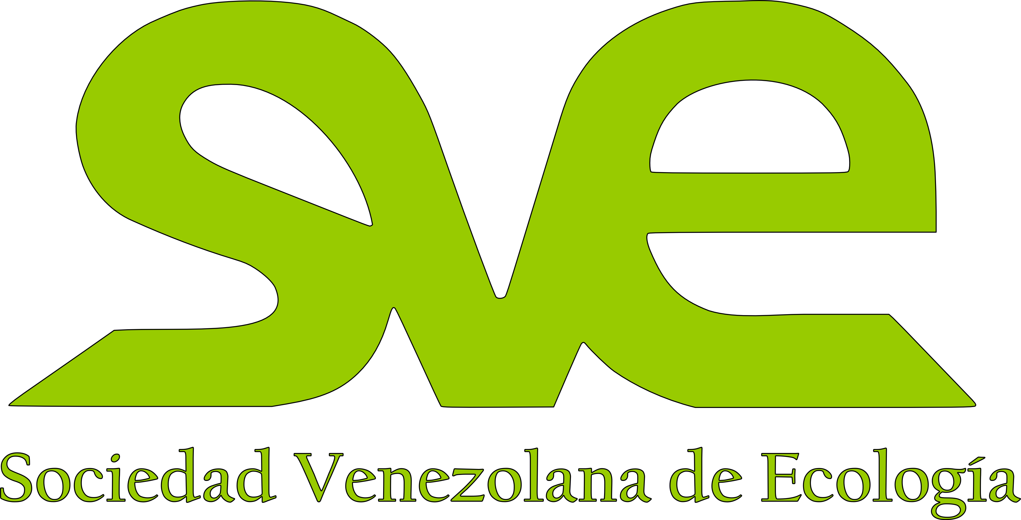
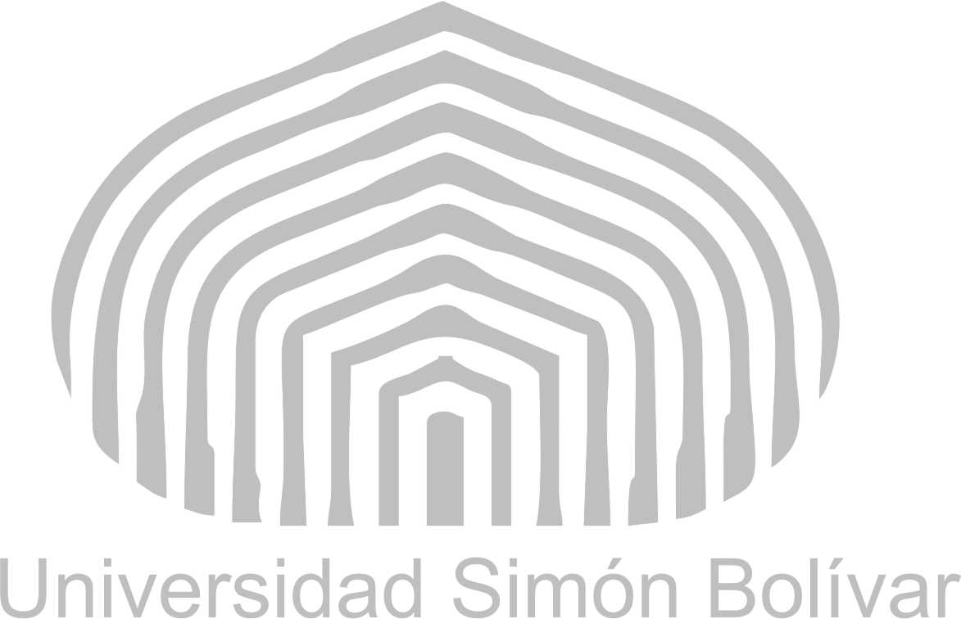
The Orinoco Mining Arc and the Caribbean
Possible impacts over marine ecological processes
Francoise Cavada-Blanco^{1,2} and Esteban Agudo-Adriani¹
¹Laboratorio de Ecologia Experimental, Universidad Simon Bolivar
²Marine Biologist, EDGE of Existence programme, Zoological Society of London
fcavada@usb.ve

Slide 2
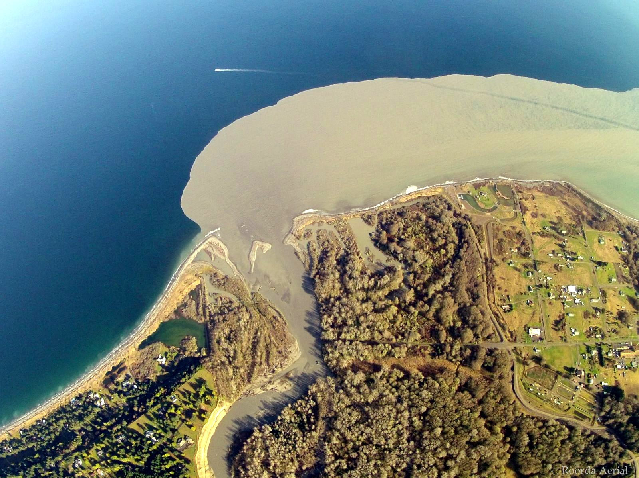
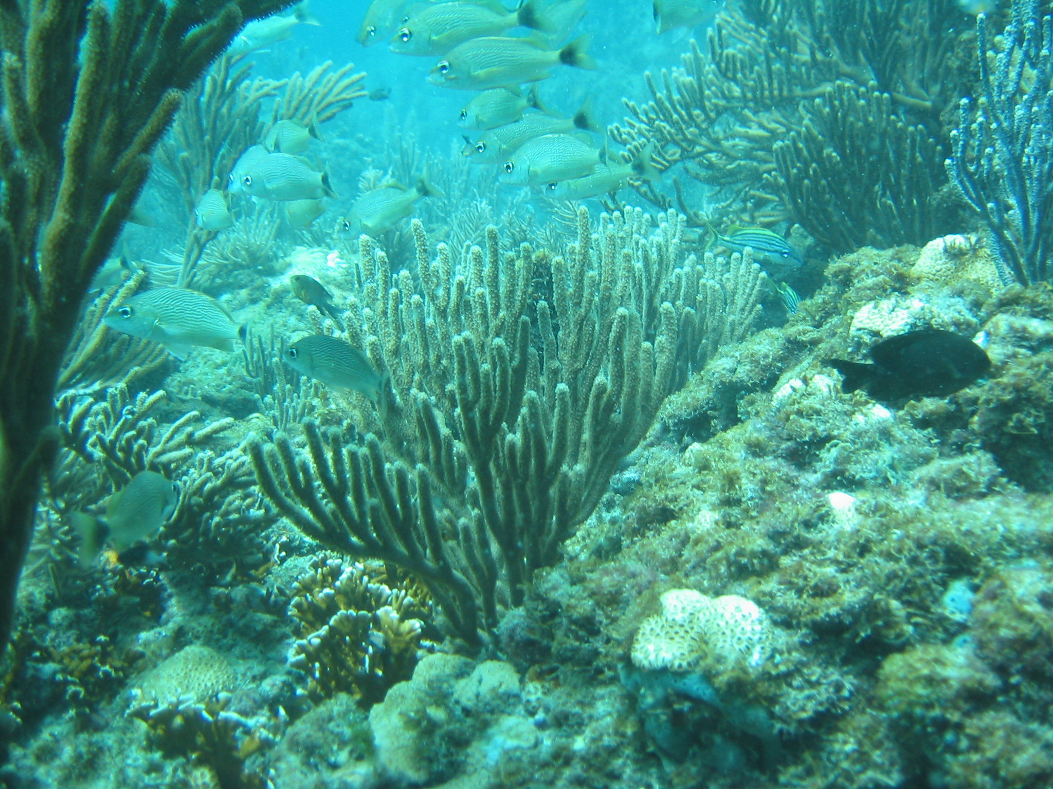
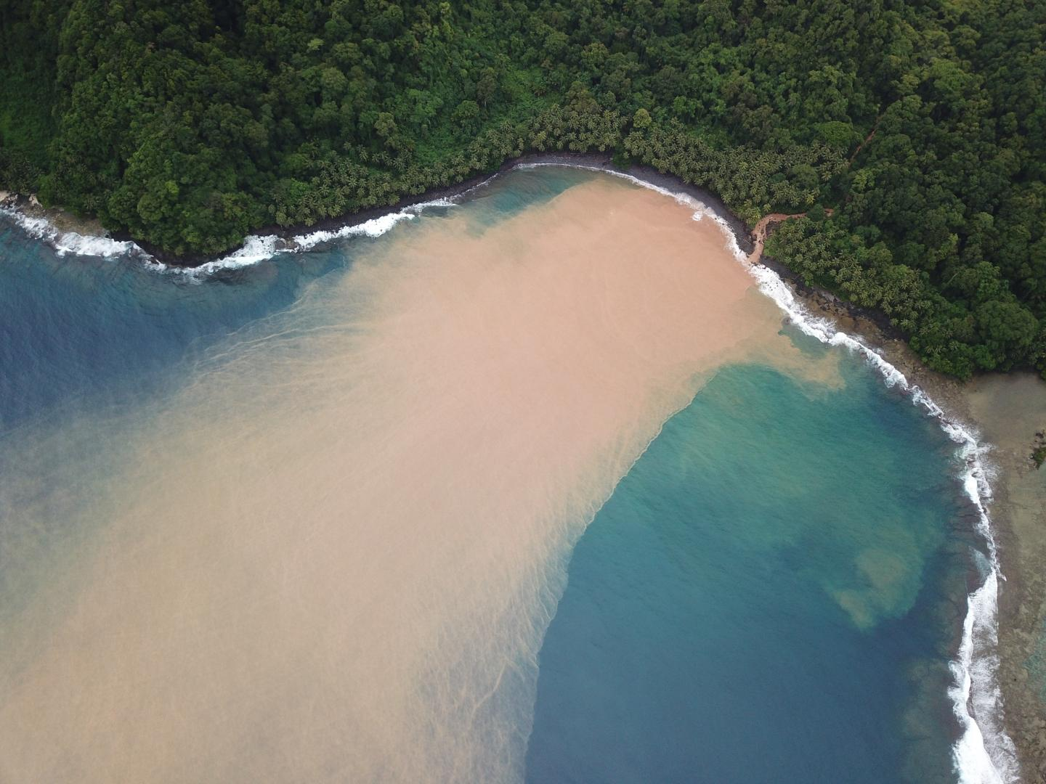
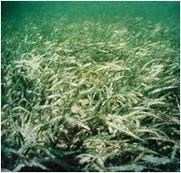
Connection between watersheds and coastal-marine ecosystems

Slide 3
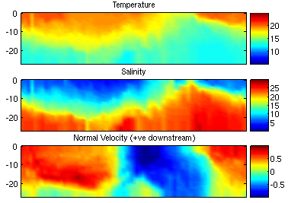
River’s influence
transport
Land-use change
Nutrients
Xenobiotics
Sediments
Eutrophication
Pollution
Sediment load
Salinity and temperature
Oceanographic processes
ECOLOGICAL PROCESSES
Source:aquarios.nasa.gov
Extent
Source:omg.unb.ca

Slide 4
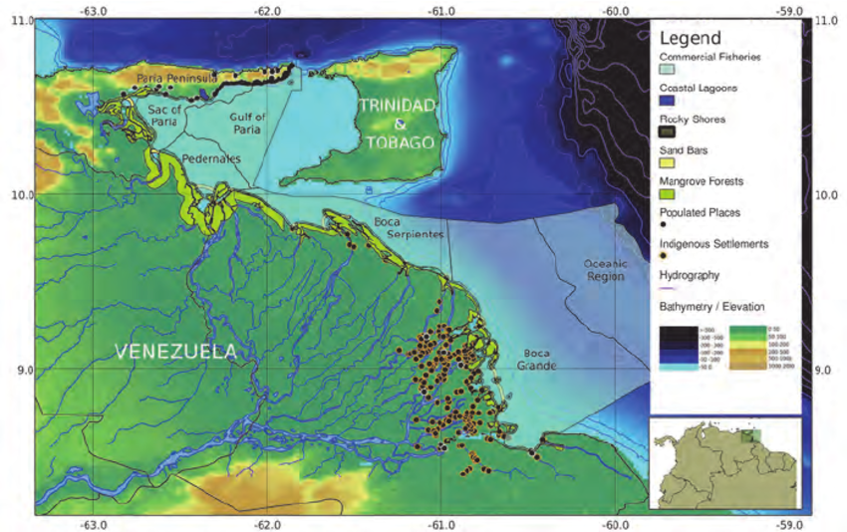
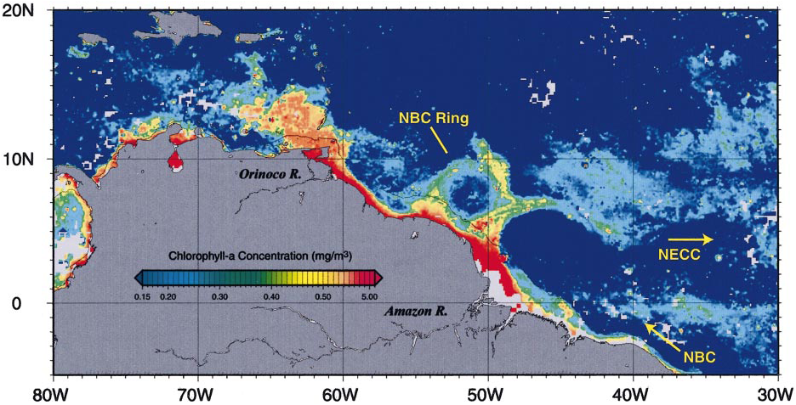
Orinoco Influence on the Caribbean
Discharge: 38,000 m³/s
Source: Miloslavich et al., 2011
Mining Arc
Source: salinityremotesensing.ifremer.fr
Rodriguez et al., 2007; Lopez et al., 2013

Slide 5
Orinoco Influence on the Caribbean
Rain-Drought seasons
May-Aug/Sep-Apr
Productivity
Solid Suspended Particles
Mining Arc
Source: salinityremotesensing.ifremer.fr
Rodriguez et al., 2007; Lopez et al., 2013

Slide 6
Orinoco Influence on the Caribbean
Source: https://svs.gsfc.nasa.gov/10279

Slide 7
Orinoco Influence on the Caribbean
Eddy
Planktonic larvae
Distribution
Johns et al., 2002
Baums et al., 2006
Source: Rudzin 2018

Slide 8
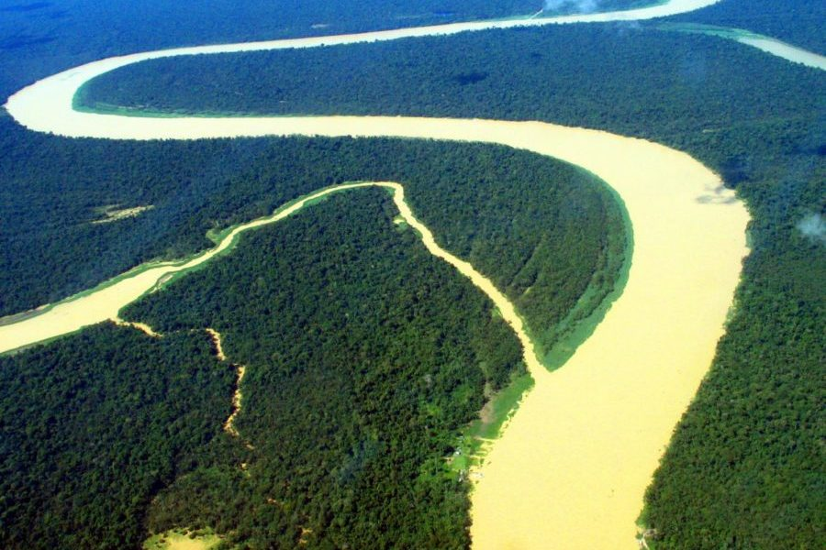
Mining impacts through the Orinoco
Eutrophication and Sediment load
Change in discharge and dynamic of the Orinoco plume
Source:Chales Brewer-Carias
Source:aquarios.nasa.gov

Slide 9
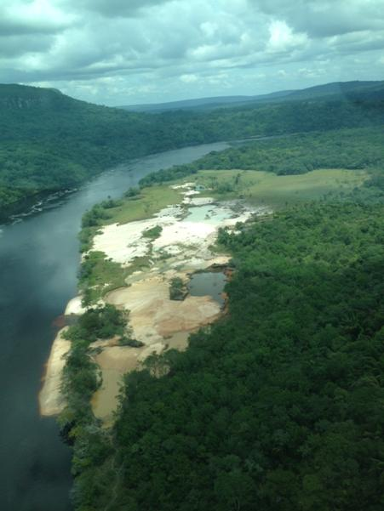
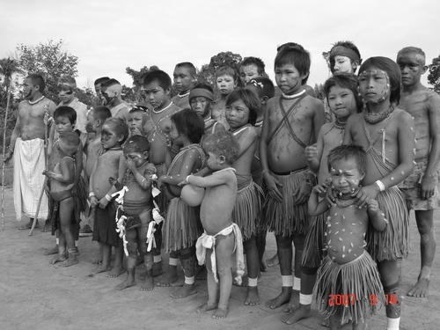
Mining impacts through the Orinoco
Pollution Hg and Cyanide
High levels of Hg in green mussels tissue and sediments from Venezuela and Trinidad
92% Yek’wana and Sanema women had high levels of Hg in blood
Source: Red ARA 2013
Astudillo et al., 2005

Slide 10
Mining impacts through the Orinoco
Generate environmental and socio-economic impacts in all the systems over which the Orinoco river exerts an influence
Potential damage of the mining activities southern of the Orinoco upon other countries ecosystems and environmental services derived from them highlights the importance of beginning to monitor for their spread

Slide 11
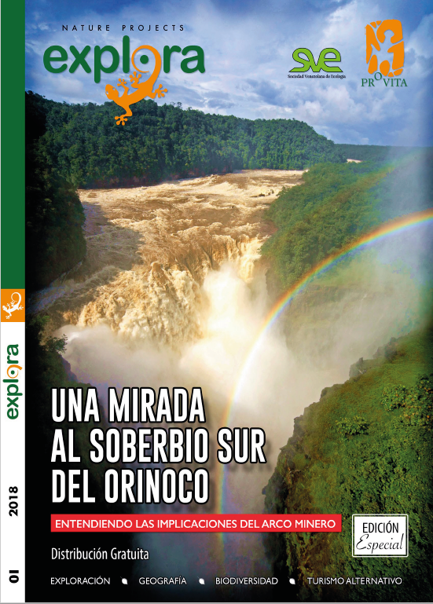
Thank you
“Having land and not ruining it is the most beautiful art that anybody could ever want”
-Andy warhol

